Slide 1


Product Overview Low-code app development

Slide 2
Low-code app
development
Custom solution builder Build tailor-made apps to automate operations at your organization
Build powerful custom applications rapidly and launch them on-premises

Slide 3
Custom
solutions
builder
AppCreator: Advanced low-code platform to build powerful applications

Slide 4
AppCreator
Advanced low-code platform to build powerful applications
(On-premises)
Drag-and-drop app builder
Point-and-click workflow automation
Advanced auditing and granular role-based access
Custom Online portals
Sandbox environment
Multi-device apps
Build advanced dashboards by drag-and-drop
Data migration from existing ERPs
Build native, rebranded mobile apps
Integrate with other ManageEngine products
Automatic progressive web applications
SAML Authentication
Blueprints: Easy business process automation

Slide 5
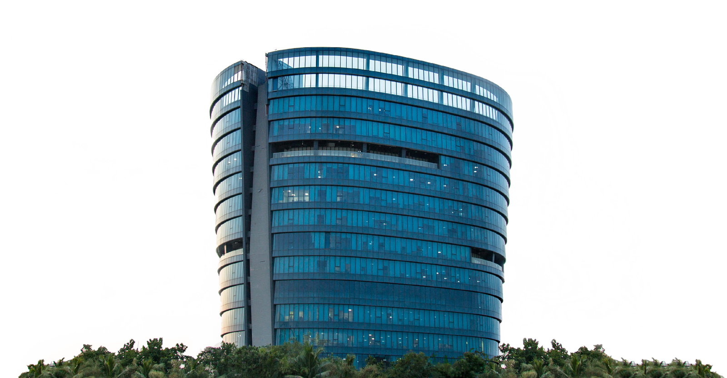

www.manageengine.com

